Slide 1
Simulation Analysis of MPPT Tracking of PV Solar System
Term Paper Presentation
Jagdish Meghwal
Subhankar Biswas
Aritra Patra

Slide 2
Content
Introduction of PV Array System
Boost Converter
MPPT Tracking
Perturbation and Observation Method
Model
Simulation Results

Slide 3

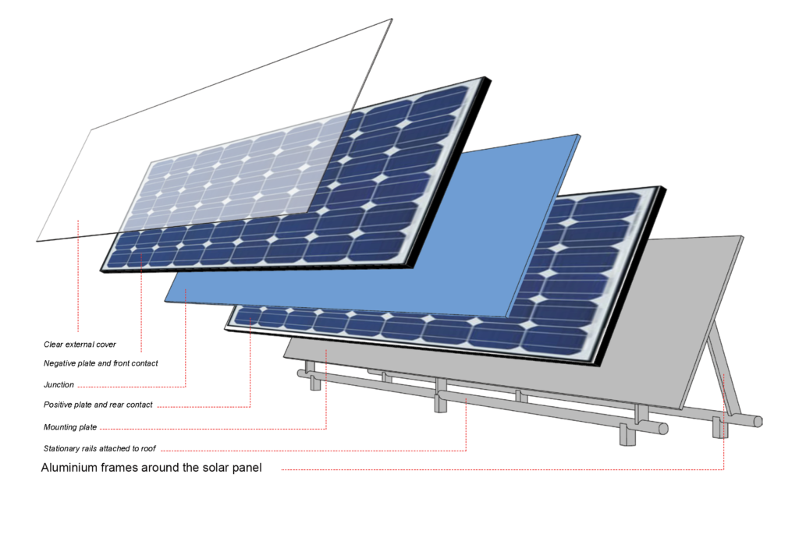
Introduction-
~ Nowadays many integrations are happening in conventional power system with renewables energy system. That is converting one grid into multiple microgrids.
~ Solar PV cells are one of the readily available sources of power generation and can be used effectively.
~ In this paper, a solar PV array system with MPPT setting is proposed.
~ A boost converter is connected to which an exact duty ratio is given to find the maximum power.

Slide 4
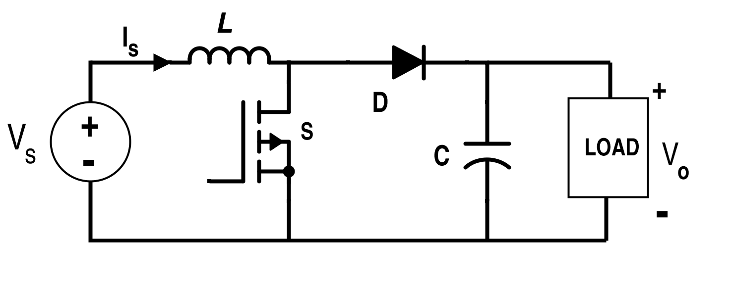
Boost Converter
As the name suggests, it takes an input voltage and boosts or increases it.
All it consists of is an inductor, a semiconductor switch, a diode and a capacitor. Also needed is a source of a periodic square wave.
V_{o} / V_{i} = 1/(1 - D)

Slide 5
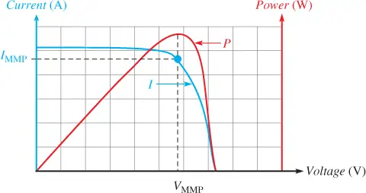
MPPT Tracking
Maximum power point tracking (MPPT) is an algorithm implemented in photovoltaic (PV) inverters to continuously adjust the impedance seen by the solar array to keep the PV system operating at, or close to, the peak power point of the PV panel under varying conditions, like changing solar irradiance, temperature, and load.
Here we will be using Perturbation and observation (P&O)for MPPT that we described in the next slide.

Slide 6
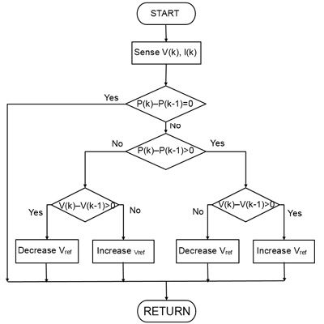
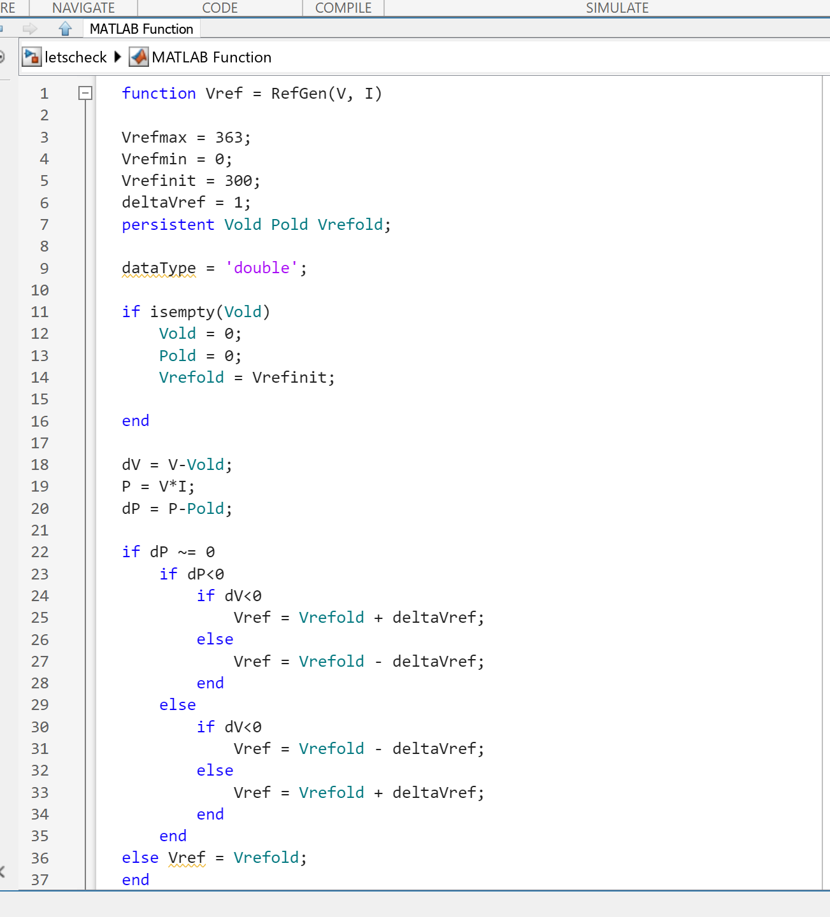
Perturbation and observation (P&O) for MPPT

Slide 7
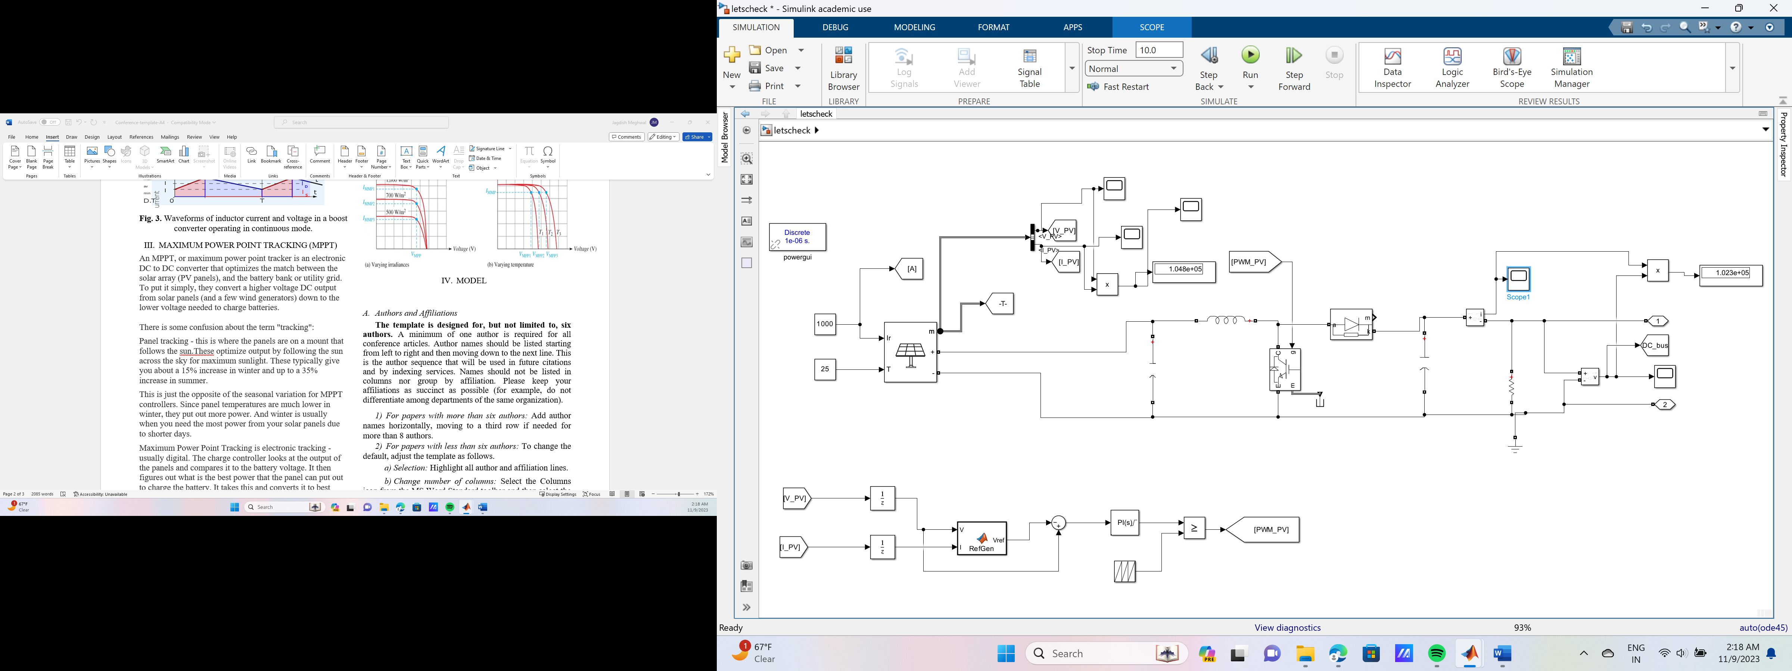
Model of PV Solar System

Slide 8
Model Data-
PV Side Data
Given irradiance= 1000 W/m2
Given temperature= 25 deg. C
Array Data-
Parallel String= 47
Series-connected modules per string= 11
Module Data-
Open Circuit Voltage(V)= 36.3
Short-circuit current Isc (A)= 7.84
Voltage at maximum power point Vmp (V)= 29
Current at maximum power point Imp (A)= 7.35
PV Voltage= 290 V
PV Current= 361.5 A
PV Power= 104.8 KW
Output Data
Output Voltage= 452.3 V
Output Current= 226.2 A
Output Power= 102.3 KW

Slide 9
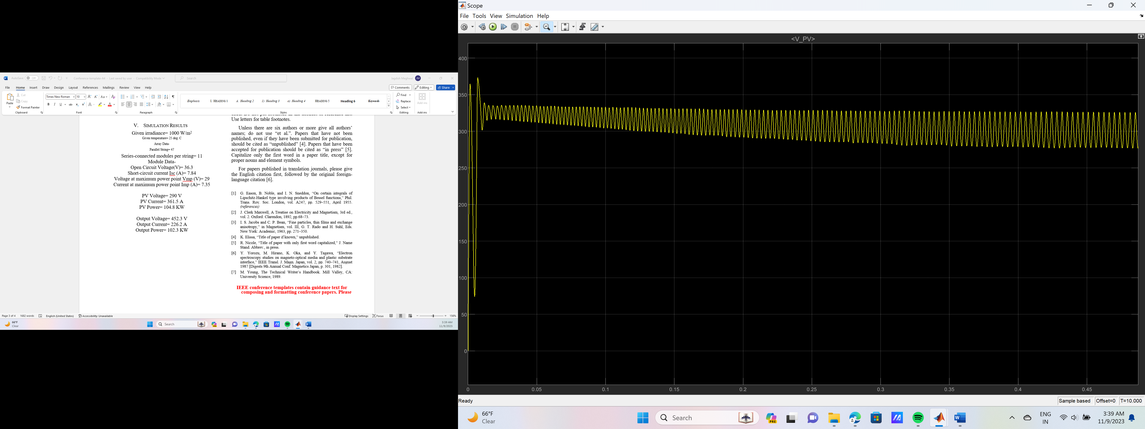
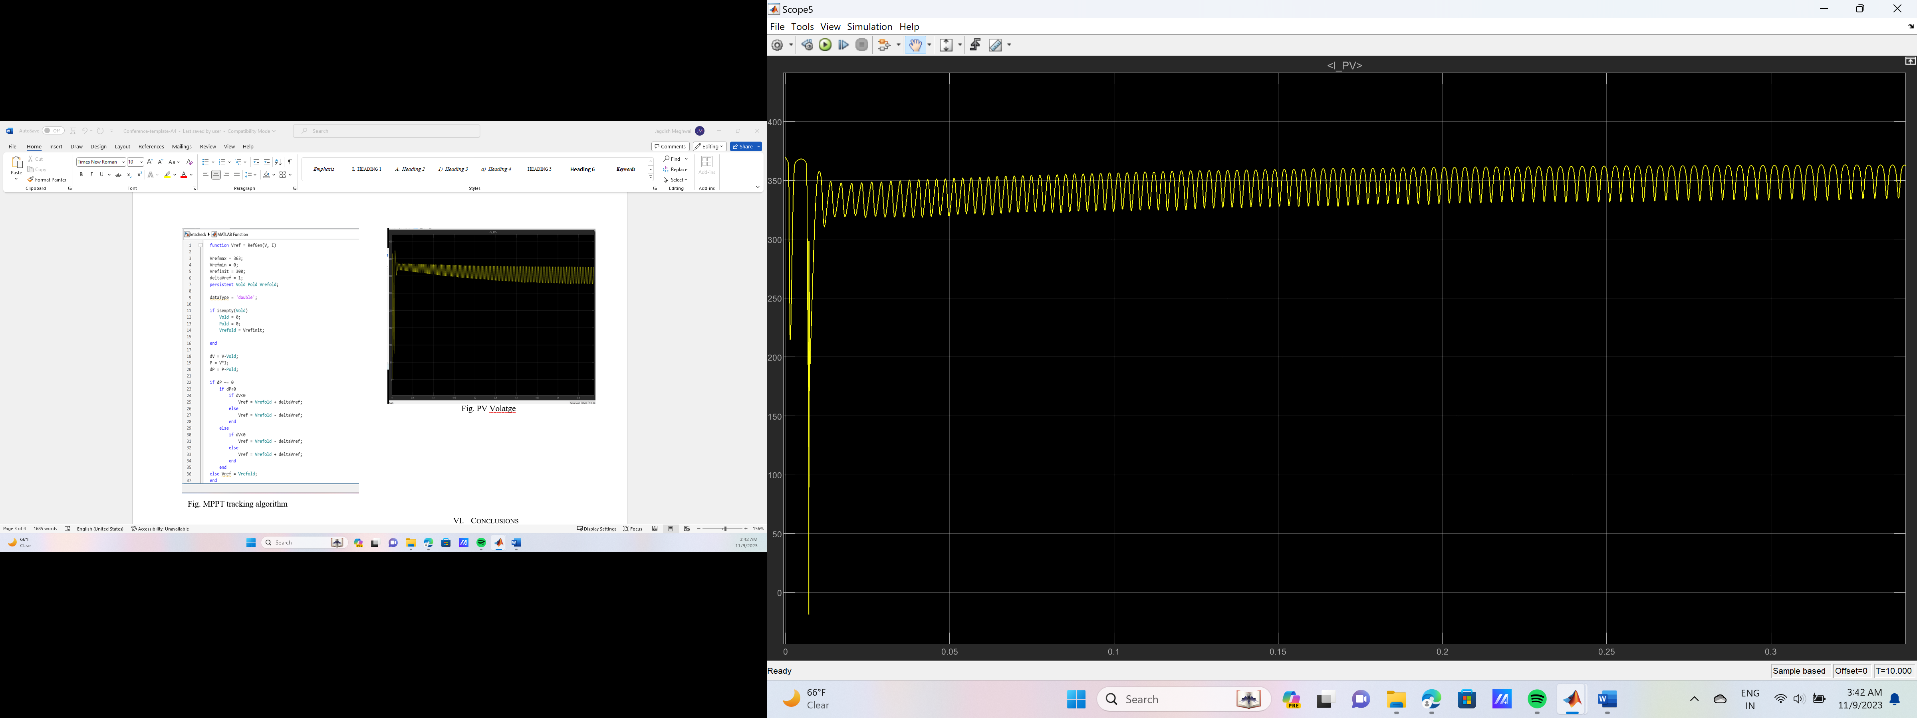
Simulation Results
Input Voltage
Input Current
Input Power

Slide 10
Output Voltage
Output Current
Output Power

Slide 11
Thank You!

